Slide 1
The Koala
The Drop Bear

Slide 2
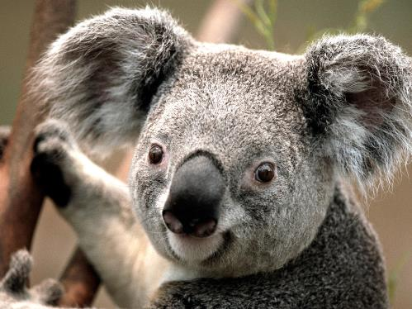
Definition
The Koala is a marsupial
Native to Australia
60-85 cm in length
Adults weight around 15kg

Slide 3
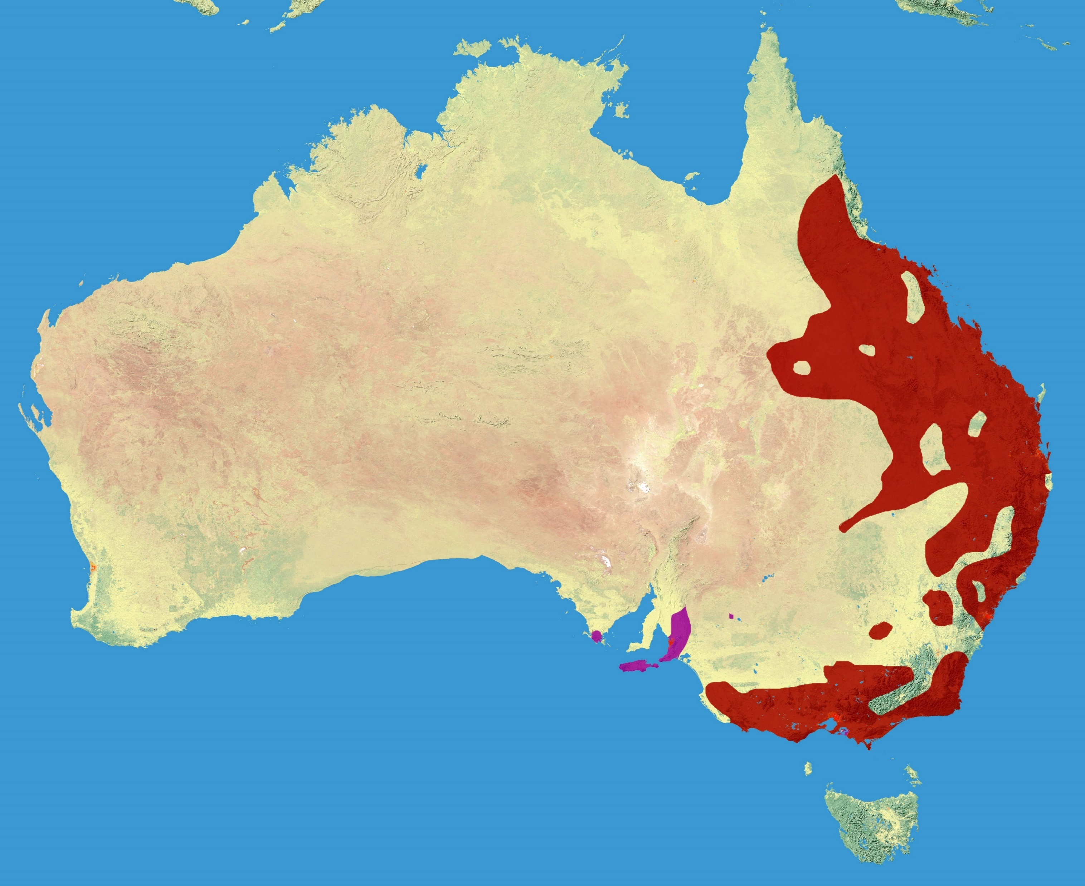
Habitat
Koala habitat is eucalyptus forests in Eastern Australia
Due to loss of habitat, they are listed as Vulnerable by the International Union for Conservation of Nature
Most of their habitat loss is attributed to urbanization and agriculture

Slide 4
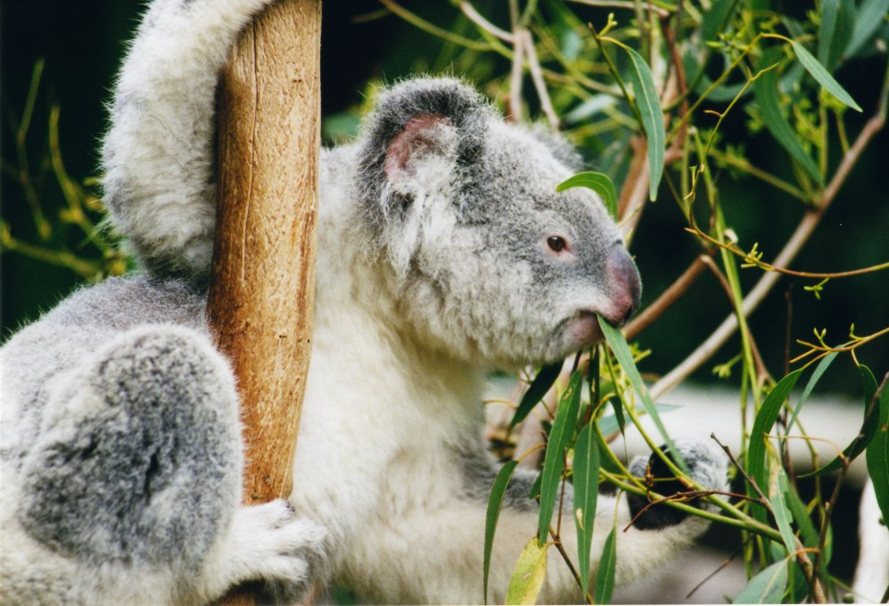
Diet
Most of a Koala’s diet is made up of leaves the Eucalyptus tree
Since this diet has so few calories, they spend almost 20 hours a day sleeping.

Slide 5
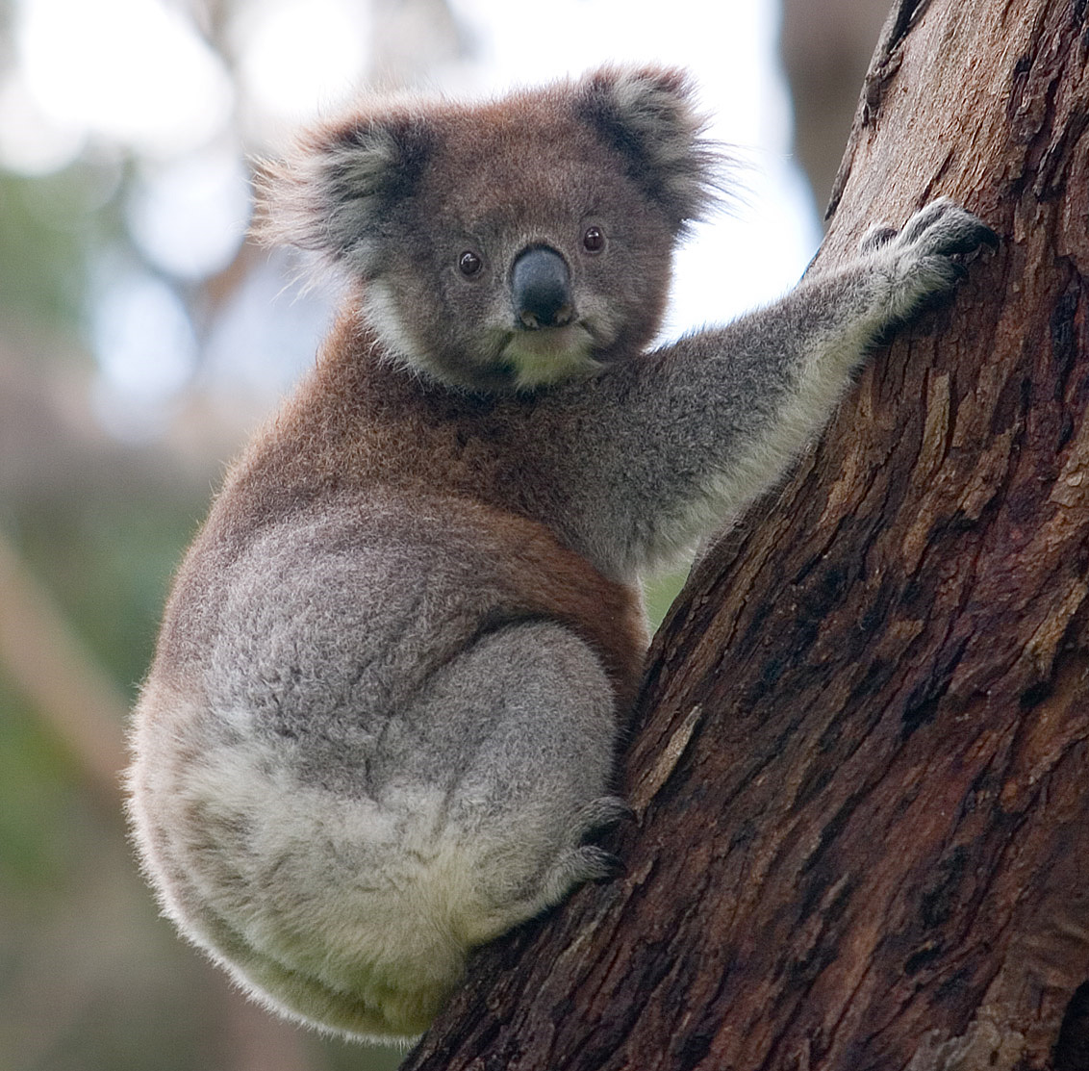
Social Habits
Koalas are not particularly social
On average, they spend about 15 minutes a day on social behaviors
Females have a tendency to choose a home
Males typically wander
Adult males communicate with loud bellows

Slide 6
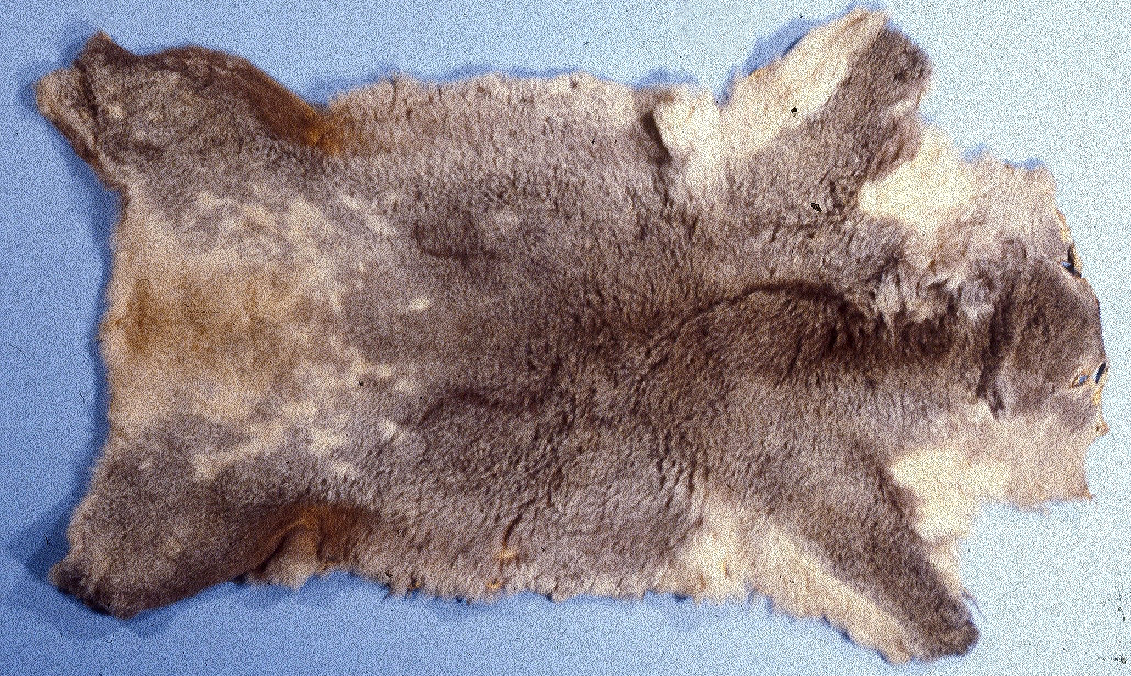
Conservation
Koalas were traditionally hunted for food by Aboriginals
Early in the 20th century, they were hunted by Europeans for their soft fur
More than two million pelts are estimated to have left Australia by 1924

